Slide 1
CS 106A, Lecture 26 Life After CS 106A, Part 2

Slide 2
Plan for today
Intro to machine learning
Supervised Learning
Applications of machine learning
Implications of machine learning
Educational Technology
Notes:
learning goals: understand basics of how ML works, its advantages, and its pitfalls

Slide 3
Learning Goals
Understand the basics of how machine learning works, its advantages, and its pitfalls
Understand that CS is just a tool – now that you have begun to wield it, what will you use it for?

Slide 4
Plan for today
Intro to machine learning
Supervised Learning
Applications of machine learning
Implications of machine learning
Educational Technology
Notes:
discussion:
how many of you have heard the terms ML / AI before?
what are some everyday examples of ML that you can think of?

Slide 5
Intro to Machine Learning
Machine Learning (ML) and Artificial Intelligence (AI) are increasingly prevalent in our lives.
It’s important to be able to think critically about these technologies, especially if you’re developing them!

Slide 6
Intro to Machine Learning

Slide 7
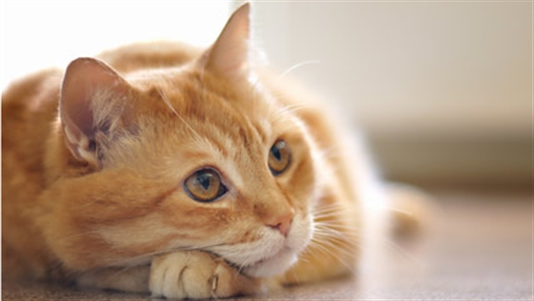

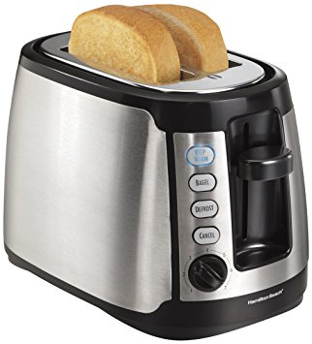

Ex: Animal Classification
We have a picture and we want to know if it’s a cat or not.
true
false
true
false

Slide 8
Ex: Animal Classification
Here’s one way you might code this…
private void isCat(GImage animal) {
int[][] pixels = animal.getPixelArray();
if (containsTwoEyes(pixels)){
if (hasWhiskers(pixels)){
if (hasPointyEars(pixels)){
return true;
}
}
}
return false;
}
Notes:
you might think of this as a series of if statements, and for a long time this is how people did predictions, more or less
can anyone think of why this code is not good?

Slide 9
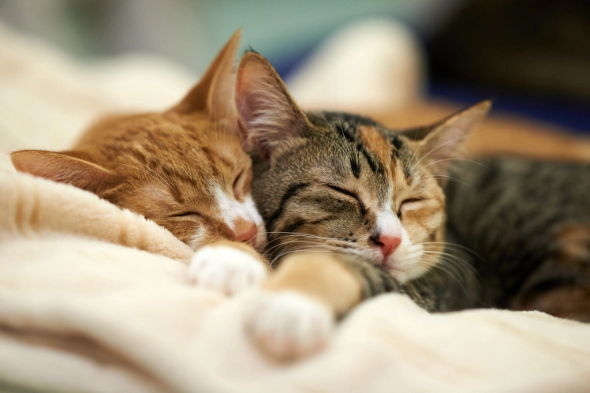

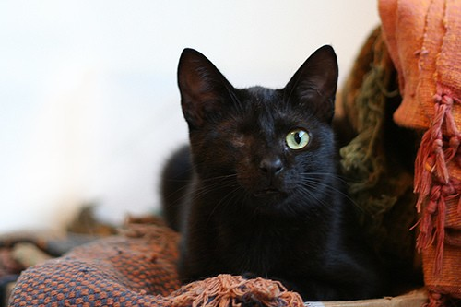
Some tricky cases

Slide 10
Pros/Cons
Pros
Matches our human intuition about what a cat is
Easy to understand the code
Cons
Requires us to explicitly enumerate every feature that’s important, and know how important it is
Need to write code to detect eyes, and whiskers, and the pointiness of ears
Will never improve… cannot learn from its mistakes

Slide 11
What is Machine Learning?
“The field of study that gives computers the ability to learn without being explicitly programmed” - Arthur Samuel, 1959
How can a computer do this?
Data.
Notes:
“How did you learn what a cat was?”

Slide 12
Train/Test Data
The algorithm gets training data that it can use to make predictions.
We use test data to evaluate how well it performs.

Slide 13
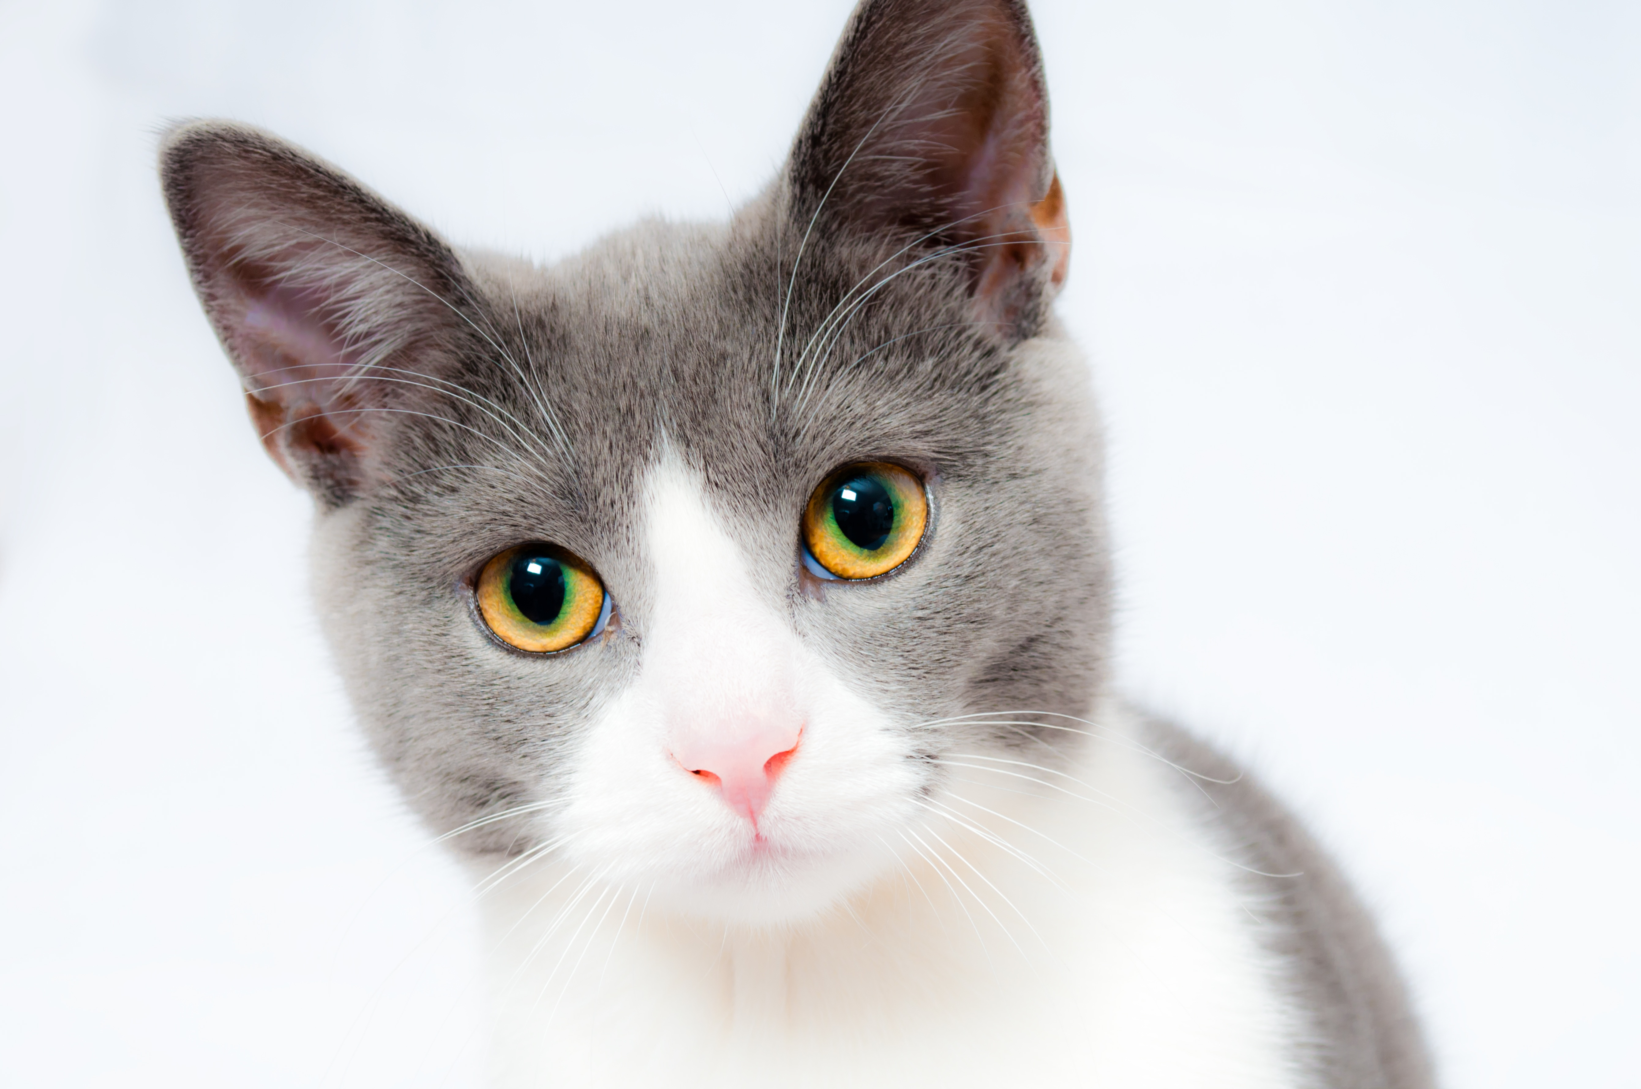
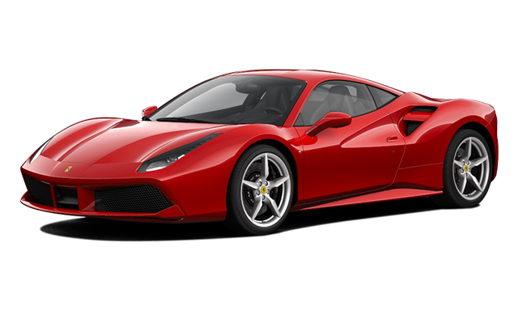
Animal Classification: Take 2
Here’s a sketch of how we can approach this problem through machine learning:
Input to the algorithm: MANY cats and MANY not-cats
cat ✅
magical
algorithm!
not cat ❌
…
not cat ✅
Notes:
If correct, great, proceed to the next image
If incorrect, update the algorithm to do better next time
concept of weights on each pixel

Slide 14
Pros/Cons
Pros
Don’t have to explicitly tell the algorithm what’s important to distinguish between cats and not-cats
Not specific to the cat problem: we could show it images of anything and train it to learn the difference
Gets better the more data we give it
Cons
Sometimes hard to know why the algorithm makes the predictions it does
Requires us to specify an update mechanism: how is the algorithm supposed to improve itself?
Might require a lot of data to perform well
Notes:
update mechanism: lots of linear algebra

Slide 15
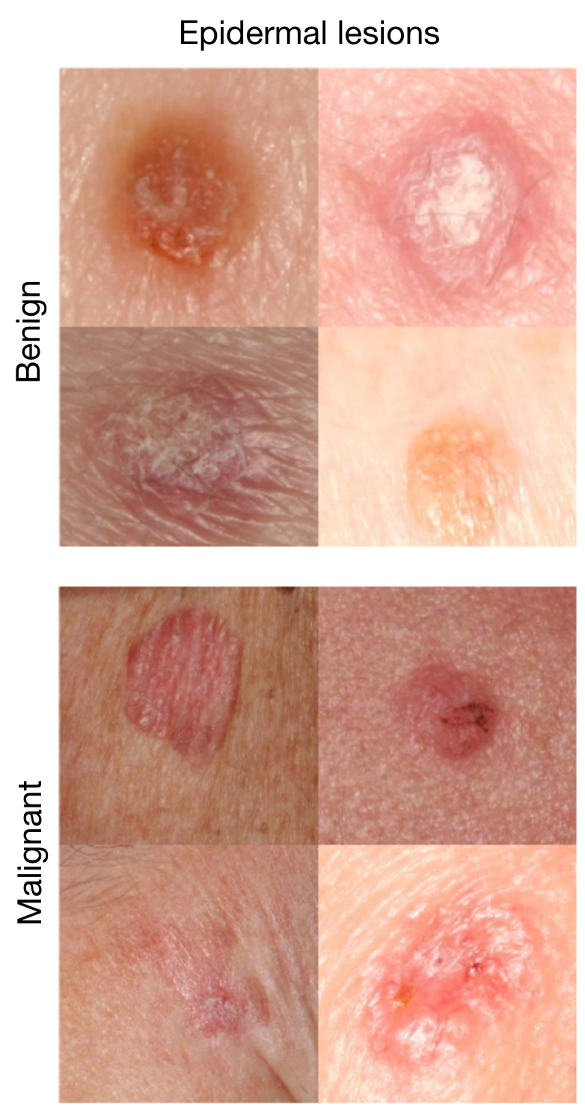
Where is this useful?
Skin cancer classification
Is a given lesion benign or malignant?
A machine learning algorithm has been shown to perform as well as dermatologists.
Esteva et al., Nature 2017.

Slide 16
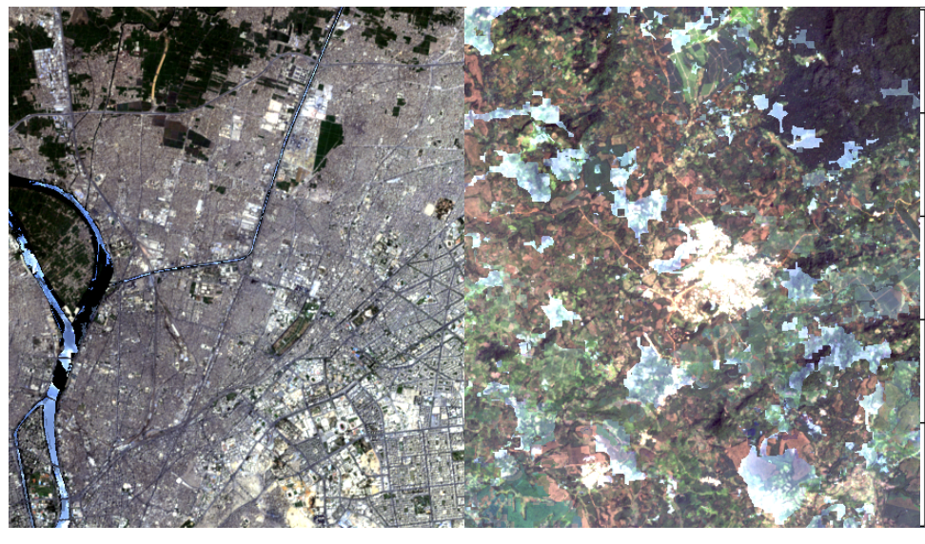
Where is this useful?
Predicting infrastructure development from satellite images
previously required intense field surveys with large data gaps
There are other tasks where machine learning algorithms perform better than skilled humans.
piped water
no piped water
Oshri et al., 2018.

Slide 17
Plan for today
Intro to machine learning
Supervised Learning
Applications of machine learning
Implications of machine learning
Educational Technology
Notes:
12-15min

Slide 18
Supervised Learning
Supervised learning is when you know the “ground truth” correct answers
ex: classifying cats, skin lesions
Unsupervised learning is when you don’t –
this is a much harder problem!
ex: text extraction, discovering new drugs

Slide 19
Ex: Digit Classification
Task:
Given a picture of a handwritten digit from 0-9, predict which integer it is
→ 3
→ 4
“label”
→ 2
→ 9

Slide 20
k-Nearest Neighbors
live demo!
Notes:
need 9 volunteers
most basic baseline algorithm (doesn’t involve an update mechanism so it’s pretty naïve still! but works surprisingly well)

Slide 21
k-Nearest Neighbors
Idea: when given a test input, look through all the training examples to find the “closest” one.
Under the assumption that “close” inputs share the same label, return the label of that closest training example.
Notes:
What does it mean for two inputs to be “close”?

Slide 22
k-Nearest Neighbors
Idea: when given a test input, look through all the training examples to find the k “closest” inputs.
Under the assumption that “close” inputs share the same label, return the most common label of the k closest inputs.
Notes:
need to have a good distance definition
code will be uploaded (show briefly)

Slide 23
Plan for today
Intro to machine learning
Supervised Learning
Applications of machine learning
Implications of machine learning
Educational Technology
Notes:
20-25min

Slide 24
What else can ML do?
Supervised Learning
Classification, like the cat or skin cancer or digits examples
Regression

Slide 25
Regression Example
House price prediction
Training Data
Test Time
Square Footage | # Bedrooms | # Bathrooms | House Price
1,000 | 2 | 1 | 150,000
1,256 | 1 | 1 | 175,000
5,897 | 5 | 2 | 2,000,000
4,300 | 3 | 2 | 1,300,000
2,400 | 3 | 3 | 750,000
2,600 | 2 | 1 | 690,000
3,000 | 4 | 2 | 1,000,000
“My house has 1,800 square feet,
2 bedrooms, and
2 bathrooms.
How much should I expect it to sell for?”

Slide 26
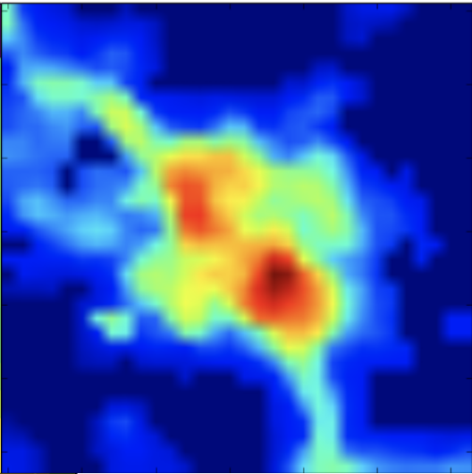
Regression Example
Poverty from nightlights
Training Data
Test Time
Average household income?
Xie et al., 2016.
Notes:
talk about Data for Development

Slide 27
What else can ML do?
Supervised Learning
Classification
Regression
Unsupervised Learning
Finding structure in unlabeled data

Slide 28
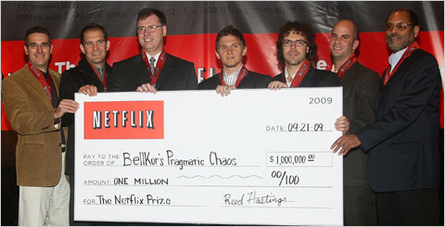
Netflix Prize Example
Notes:
goal: improve the accuracy of predictions about how much someone is going to enjoy a movie based on their movie preferences.
On September 21, 2009 we awarded the $1M Grand Prize to team “BellKor’s Pragmatic Chaos”. Read about their algorithm, checkout team scores on the Leaderboard, and join the discussions on the Forum.

Slide 29
What else can ML do?
Supervised Learning
Classification
Regression
Unsupervised Learning
Reinforcement Learning

Slide 30
AlphaGo

Slide 31
What remains really hard?
Human-like dialog
Common-sense reasoning about the world
Strong generalization
Interpretability of decisions
… and much else ☺

Slide 32
Plan for today
Intro to machine learning
Supervised Learning
Applications of machine learning
Implications of machine learning
Educational Technology

Slide 33
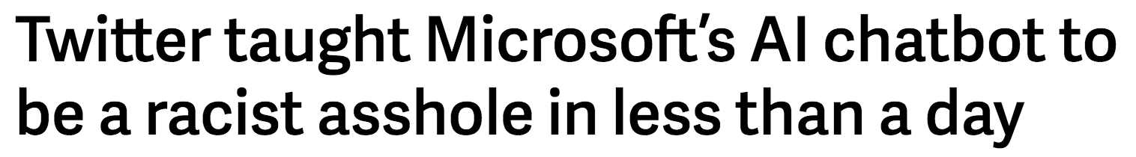
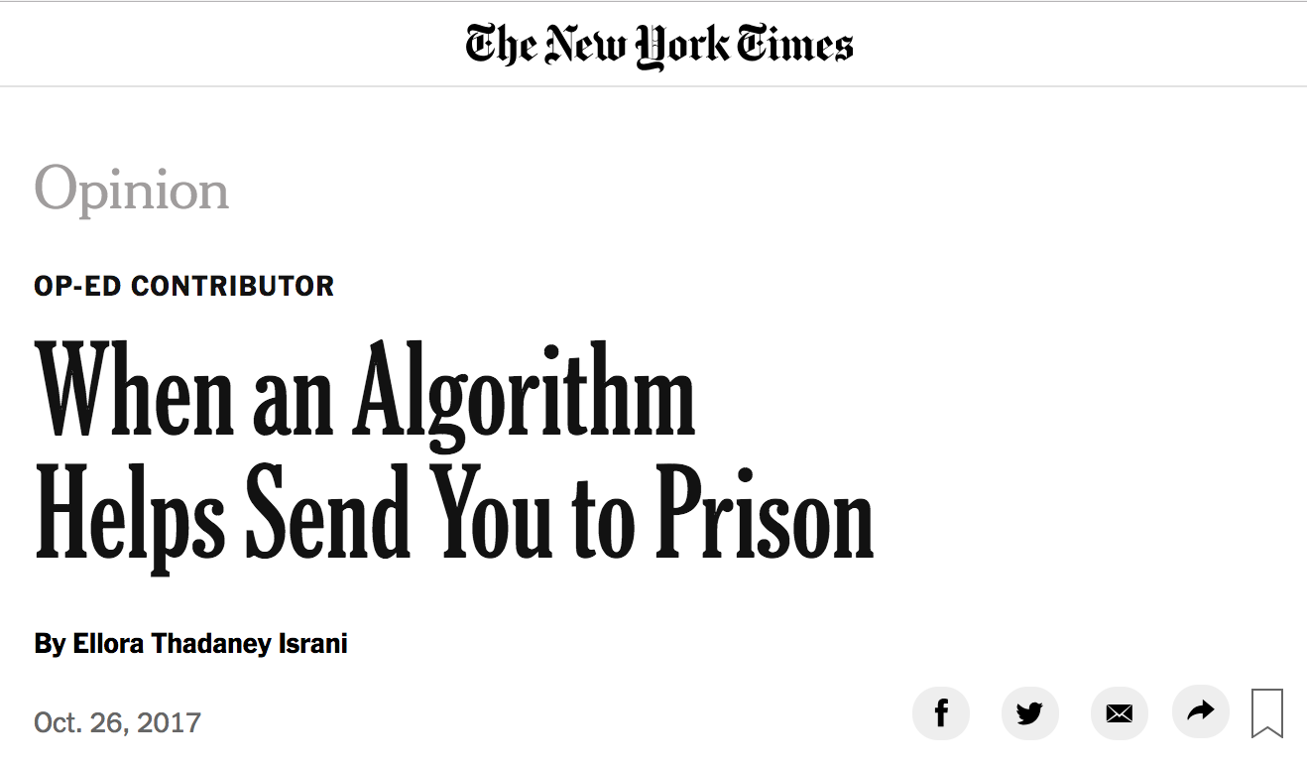
Algorithmic bias
Notes:
COMPAS, a risk assessment algorithm used by the state of Wisconsin (No one knows exactly how COMPAS works; its manufacturer refuses to disclose the proprietary algorithm)

Slide 34
Algorithmic bias
ML is powerful because it can learn from data, without explicit instruction
… but because of that, is subject to the same flaws found in data

Slide 35
Artificial Intelligence
“With artificial intelligence we are summoning the demon” – Elon Musk
Notes:
AI is an application of ML, can be blown out of proportion but also does have potential for harm

Slide 36
Recap
ML is powerful because it can learn from data, without explicit instruction
… but because of that, is subject to the same flaws found in data
… and must be used safely, with thoughtful human input

Slide 37
Plan for today
Intro to machine learning
Supervised Learning
Applications of machine learning
Implications of machine learning
Educational Technology
Notes:
40-45min

Slide 38
Educational Technology (EdTech)
MOOCs (massive open online courses)
tools to learn CS
Chromebooks / iPads in classrooms
online / AI tutoring
autograding
circuits / Arduinos / Raspberry Pi
…and so much more
Notes:
chart ya own path

Slide 39

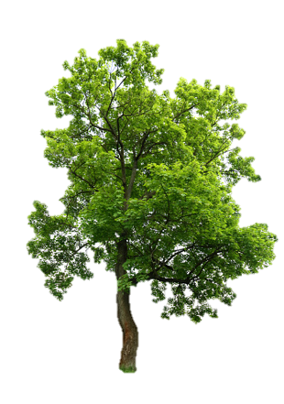
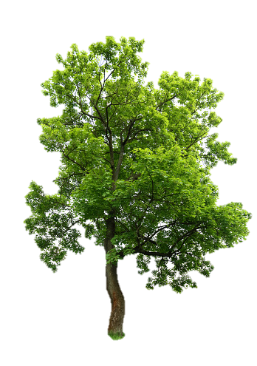
some probably unrealistic holy grail
???
CZI
Maker
spaces
106A Tools
Annie’s (simplified) River of CS + Education

Slide 40
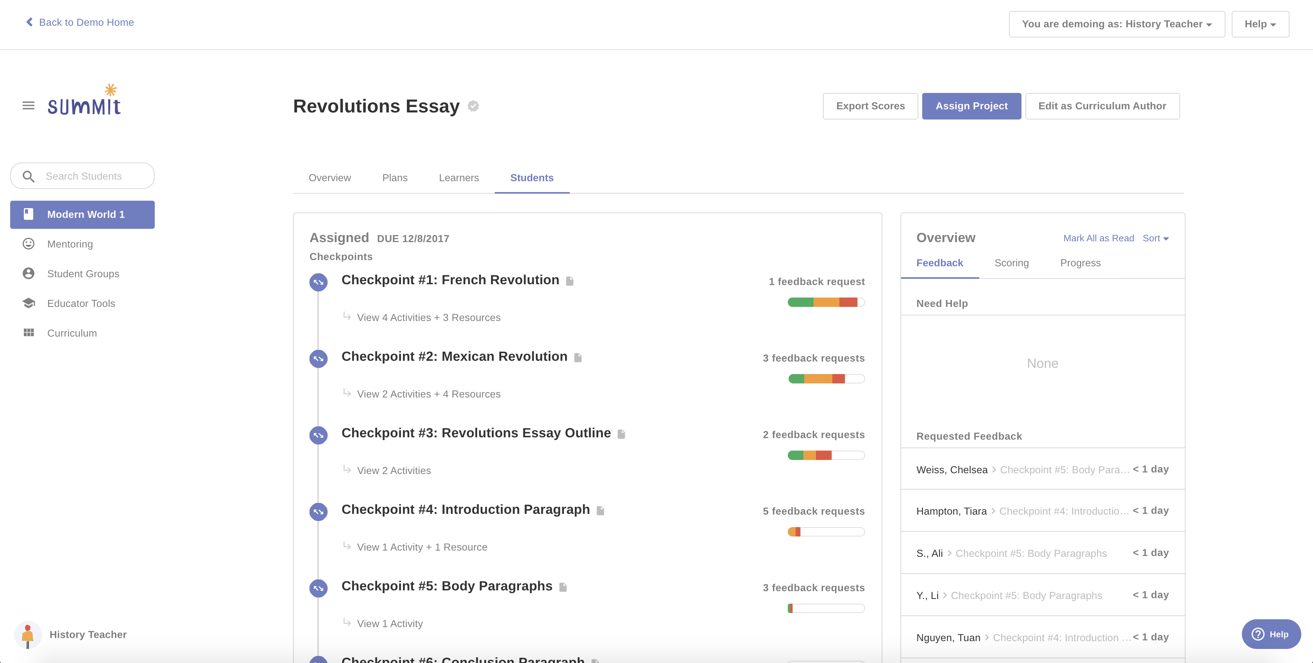
Personalized Learning

Slide 41
Recap
like much of tech + social good, the answers are unclear
best solution may not involve tech at all!
important to stay close to the problem and stay empathetic :-)

Slide 42
Recap
Intro to machine learning
Supervised Learning
Applications of machine learning
Implications of machine learning
Educational Technology
Next time: final review 😱

